Slide 1

Department of Computer Science & Engineering
Artificial Intelligence & Machine Learning
A.P Shah Institute Of Technology
G.B.Road,Kasarvadavli,Thane(W),400615.
UNIVERSITY OF MUMBAI
Academic Year 2024-2025

Slide 2

Quiz Application
Mahesh Shinde (22106128)
Unnati Shah (23106045)
Pranav Jain (22106069)
Siddhant Salunkhe (22106132)
Project Guide
Prof. Poonam Tiware

Slide 3
Outline
Introduction
Objectives
Literature Survey of the Existing Systems
Features
Proposed System Design
Block Diagram
Implementation(Screenshots )
Conclusion
References

Slide 4
Introduction
Quiz Application : This project is a Java- based quiz application that allows users to take a quiz by answering multiple-choice questions.
Interactive GUI : It features an interactive graphical user interface (GUI) built using java Swing, making it user-friendly and visually appealing.
Score tracking : The application tracks and displays the user’s score, providing instant feedback on their performance upon completingthe quiz.

Slide 5
Objectives:
Assess Knowledge : Evaluate users Knowledge on various topics.
Interactive Learning : Provide an engaging way to learn through quizzes.
User-Friendly Interface : Offer a user-friendly and visually appealing GUI.
Scoring System : Track and display user’s scores in real-time.
Multiple Questions : Present a series of single-choice questions.
Educational Fun : Create a fun and educational experience for users

Slide 6
Literature Survey of the existing system
Smith, K. (2021). A History of Gaming. Gaming Publications. ISBN: 978-1234567890.
• K. Smith’s 2021 book, A History of Gaming, provides an in-depth exploration of the evolution of games from their ancient origins to the modern era. It begins by tracing the roots of gaming with early board games and recreational activities, then delves into the development of video games and arcade classics like Pong and Space Invaders. The book highlights the golden age of gaming, marked by the rise of iconic consoles such as the Atari 2600 and the Nintendo Entertainment System (NES), and discusses the cultural impact of these early games. Moving into the digital age, Smith examines the growth of PC gaming and the emergence of online multiplayer games, including MMORPGs and competitive gaming. Through this historical lens, the book captures the transformative journey of gaming, illustrating how technological advancements and cultural shifts have shaped the industry.Wilson, C. (2023). "The Future of Quiz Games: Trends and Innovations". Future Gaming Journal, 11(2), 40-55•

Slide 7
In the 2023 article "The Future of Quiz Games: Trends and Innovations," published in the Future Gaming Journal, C. Wilson explores emerging trends and technological advancements shaping the future of quiz games. The article examines how innovations such as augmented reality (AR), virtual reality (VR), and artificial intelligence (AI) are poised to revolutionize the quiz game genre. Wilson discusses the integration of these technologies to enhance user engagement and create more immersive and adaptive quiz experiences. The paper also highlights potential developments in game design and mechanics, emphasizing how these innovations could transform traditional quiz formats and offer new opportunities for interactive learning and entertainment. Through a forward-looking perspective, Wilson provides insights into how quiz games might evolve and adapt to future technological and cultural shifts

Slide 8
Features :
Question Progression: Users can navigate through a series of questions one at a time.
Scoring System: The application calculates and displays the user’s score based on correct answers.
Interactive Interface: A user-friendly graphical interface makes answering questions intuitive.
Randomized Questions: Questions can be randomized for each quiz session to enhance variety.
Single-Choice Questions: Users select one correct answer from multiple options for each questions.
Quiz Completion: The application provides feedback and displays the final score upon completing the entire quiz.

Slide 9
Proposed System Design
User-Friendly Interface:
o GUI Design: The system will feature a visually appealing graphical user interface (GUI) developed using Java Swing, ensuring a seamless and intuitive user experience.
o Real-Time Feedback: Immediate feedback will be integrated, highlighting correct answers upon selection, enhancing user engagement and understanding.
Educational Focus:
o Assessment: The system will serve as a tool for educational assessment, allowing users to test their knowledge on a variety of subjects.
o Customization: Educators and administrators will have the ability to add, modify, and organize quiz content, adapting it to specific educational goals

Slide 10
Java Skill Development:
o Practical Learning: The system will provide a hands-on opportunity for developers to enhance their Java programming and Swing GUI development skills.
Scalability and Progress Tracking:
o Future Expansion: The system will be prepared for future growth, accommodating additional questions and themes to meet evolving educational needs.
o Progress Monitoring: Users will be able to track their learning progress and performance, identifying areas for improvement

Slide 11
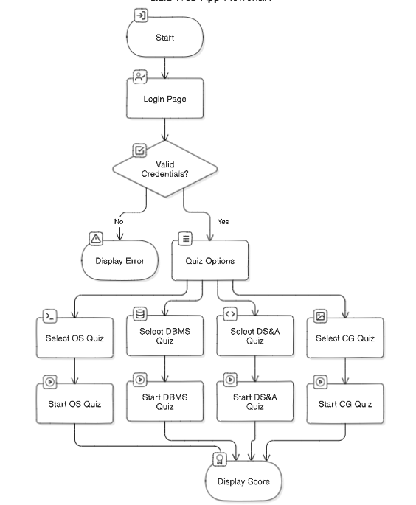
BLOCKDIAGRAM:

Slide 12
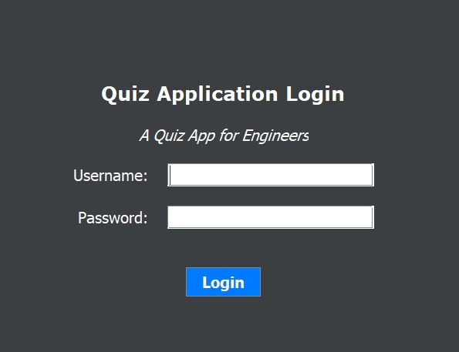
Implementation(Screenshots )

Slide 13


Slide 14
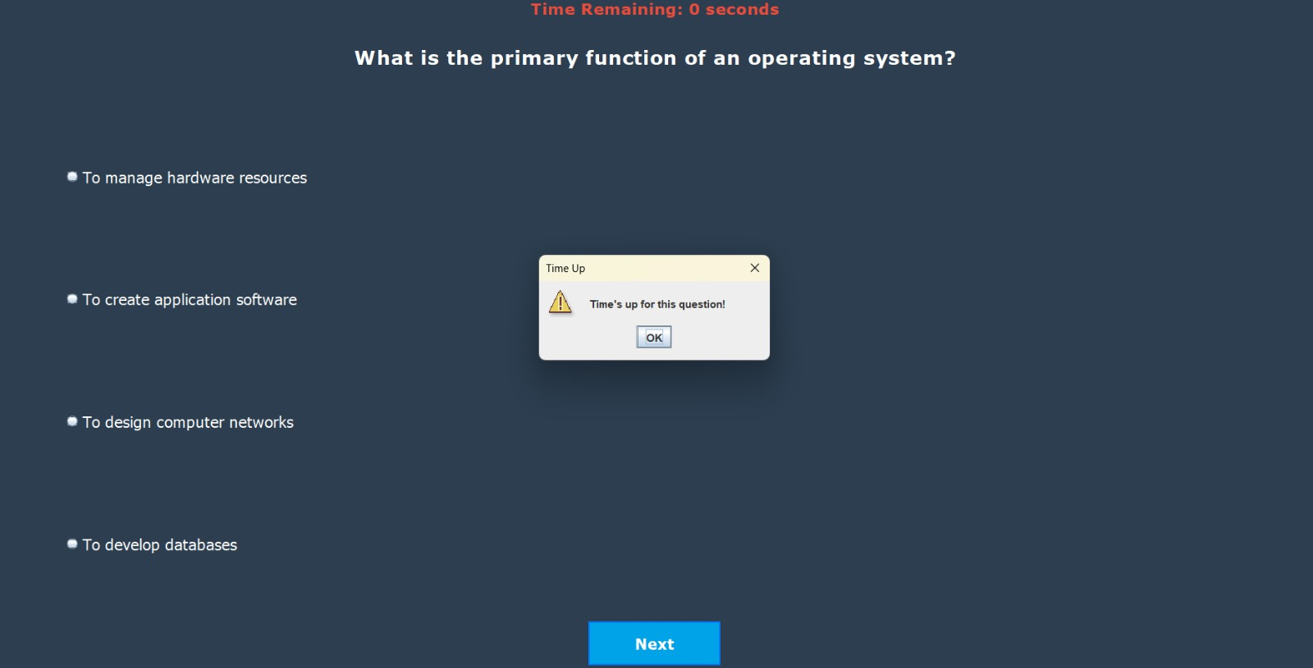

Slide 15
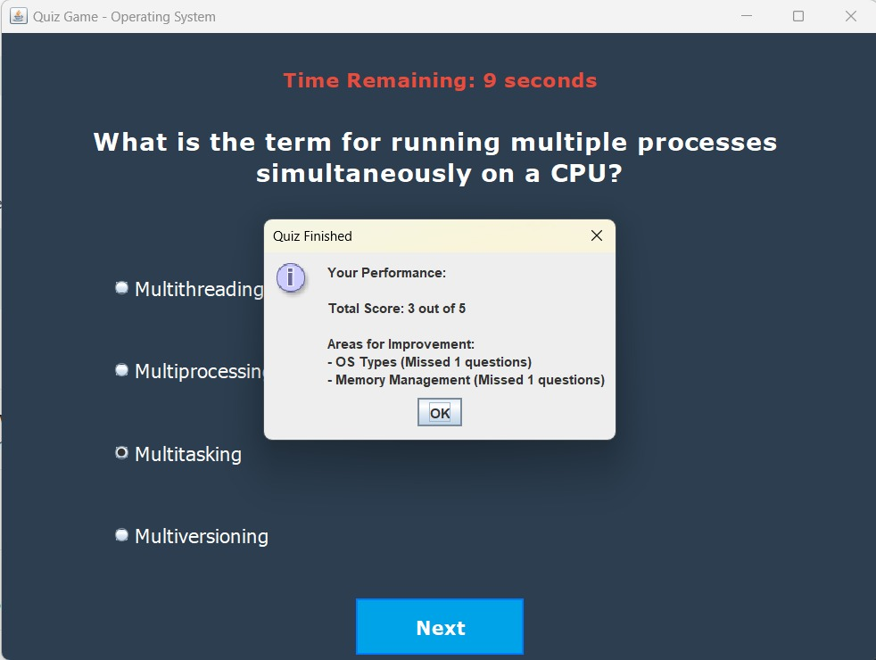

Slide 16
Conclusion:
Engaging Learning Tool: The quiz application offers an engaging and interactive way for users to test their knowledge across various topics.
User-Friendly Interface: Its user-friendly graphical interface and real-time feedback make it accessible and enjoyable for users of all ages.
Educational Value: The project serves as an effective educational tool, fostering learning through quizzes and providing immediate score feedback.
Customizable and Extensible: The code can be extended to include more questions and topics, making it adaptable for a wide range of educational purposes.
Enhanced Skills: By building this quiz application, you’ve gained valuable

Slide 17
References
Smith, J. A., & Johnson, M. L. (2019). The Impact of Interactive Quiz Applications on Student Learning. Journal of Educational Technology, 32(4), 567-581.
Brown, S. R., & Davis, E. K. (2021). Customization and Personalization in Educational Assessment with Interactive Quizzes. Educational Assessment, 45(2), 301-315.
Turner, R. L., & Harris, P. W. (2018). Improving Assessment through Immediate Feedback: A Case Study of Quiz Applications. Journal of E-Learning, 29(1), 45-59.4.
Oracle's official Java Swing documentation.
"Java Swing" by John Zukowski (book on Java Swing programming)

Slide 18
Thank You...!!

